Slide 1

Exception Handling
By: Jonathan Penaloza

Slide 2
What are errors
Syntax errors
Exceptions
Notes:
Python errors can be either syntax errors or exceptions.
Errors are issues in a program that cause it to halt during execution.
On the other hand, exceptions are raised when internal occurrences take place that alter the program's usual course.

Slide 3

Syntax Errors
amount = 10000
# check that You are eligible to
# purchase Dsa Self Paced or not
if(amount>2999)
print("You are eligible to purchase Dsa Self Paced")

Slide 4

Logical errors(Exception)
When in the runtime, an error that happens after the syntax test succeeds is referred to as an exception or logical type.
For instance, the ZeroDivisionError exception, and the ImportError exception is raised when we attempt to import a module that doesn't exist.
EX:
marks = 10000
# perform division with 0
a = marks / 0
print(a)

Slide 5
Exception handling
Try and Except Statement – Catching Exceptions
"Try" and "except" statements are used to catch and handle exceptions in Python. Statements that can raise exceptions are kept inside the try clause and the statements that handle the exception are written inside except clause.
Try with Else Clause
you can also use the else clause on the try-except block which must be present after all the except clauses. The code enters the else block only if the try clause does not raise an exception.
Raising Exception
The raise statement enables the programmer to force the occurrence of a particular exception. raise's lone argument specifies the exception that should be raised. Either an exception instance or an exception class must be present here (a class that derives from Exception).

Slide 6
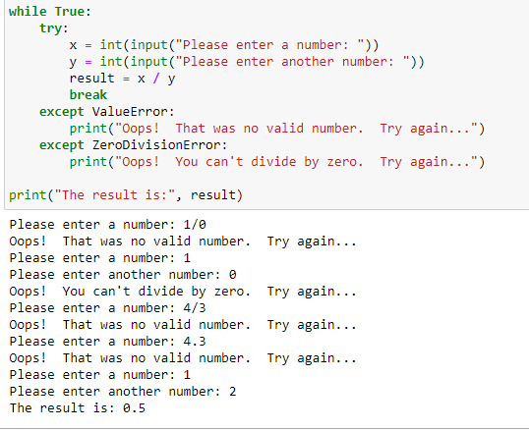
Examples of Exception handling

Slide 7
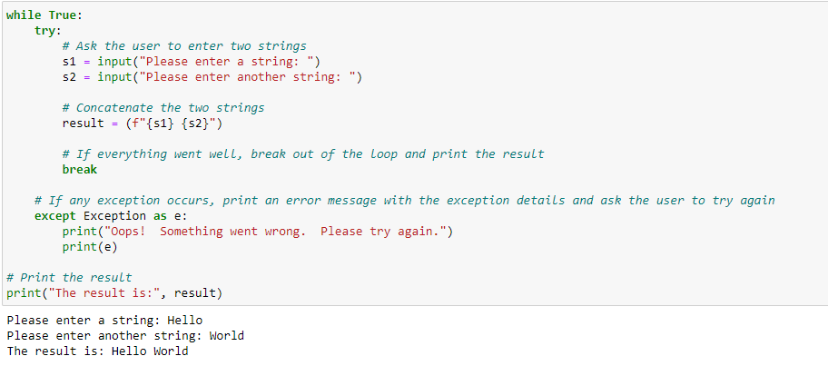
Another example using strings

Slide 8
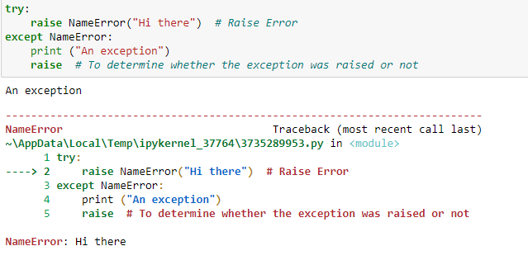
Last Example using raise

Slide 9
Citation
Error Types in Python (tutorialsteacher.com)
Errors and Exceptions in Python - GeeksforGeeks
Python Exception Handling - GeeksforGeeks
How to handle exception inside a Python for loop (tutorialspoint.com)

